Slide 1
Pre-Solicitation Offeror’s Conference
U.S. Probation AND PRETRIAL OfficeS
May 29, 2025

Slide 2
Welcome!!
Northern District of Illinois Probation Treatment Services Team
Tracy Zacchigna, Supervisory U.S. Probation Officer
  Nicholas Macker, Supervisory U.S. Probation Officer
  Taylor Sevier, Supervisory U.S. Probation Officer
  Carrie Holberg, Supervisory U.S. Probation Officer
  Robert Zamarelli, Senior U.S. Probation Officer/Contracting Officer
  Seth Grennan, Senior U.S. Probation Officer
  Brian Doranzo, Senior U.S. Probation Officer
  Nicole Roman Argueta, Senior U.S. Probation Officer
  Laminta Poe, Senior U.S. Probation Officer
  Morgan Calhoun, Senior U.S. Probation Officer
  Lisa Tarquinio, Senior U.S. Probation Officer
Notes:
1-8 Tracy
9-12 Nick
13-18 Robert
19-28 Taylor
29-35Tracy

Slide 3
agenda
Overview of Services Needed
  Distinction between USPO and USPSO
Vendor and Facility Requirements
Service Requirements: CBT and Risk-based Supervision
Overview of Solicitation and Audit Processes
Q&A

Slide 4
It is important to note that while we are presenting all the services our district is in need of, it does not mean your agency has to provide every type of service to submit an RFP. We will be presenting substance use services, mental health services, sex offender services, and polygraphy services. Some agencies only provide sex offender services, some agencies may only provide mental health services, etc. Towards the end of this presentation we will discuss each of the RFPs we will offer and what is included in them.

Slide 5
Substance use services
1010-Urine Collection and Reporting- The vendor shall perform the procedures related to the collection, testing and reporting of urine specimens.
2011-Substance Use Intake Assessment Report- Comprehensive biopsychosocial intake assessment and report conducted by a state certified addictions counselor or licensed clinician. The assessor shall identify the USPO/USPSO client’s substance abuse severity, strengths, weaknesses, and readiness for treatment.
2010 Individual Substance Use Counseling- Clinical interaction between USPO/USPSO client’s and a trained and certified counselor. The interactions are deliberate and based on various clinical modalities, which have demonstrated evidence to change behavior.
2020 Substance Use Group Counseling- 2 to 12 USPO/USPSO clients led by a trained and certified counselor as defined in SOW. Treatment shall include the use of cognitive and behavioral techniques to change defendant/offender thought patterns while teaching pro-social skill building.
2030 Family Counseling- USPO/USPSO client and one or more family members. The vendor may meet with family members without the offender present with USPO/USPSO approval.

Slide 6
Substance use cont’d.
2001-Short Term Residential- Facilities provide a highly structured environment that incorporates counseling, drug testing, and other approaches that involve cooperative living for people receiving treatment. Must have 6 hours of structured programs per day (3 of those must be clinical group).

Slide 7
Mental health services
5011-Mental Health Assessment-Performed by a masters or doctoral level practitioner who is licensed or certified and meets the standards of practice established by his/her state regulatory board.
5030-Psychiatric Evaluation- To establish a psychiatric diagnosis, to determine the need for psychotropic medications and/or to develop an initial treatment plan with particular consideration of any immediate interventions that may be needed to ensure the USPO/USPSO client’s safety and that of the community.
6016 – Co-Occurring disorders Assessment- To establish the chronological substance abuse and mental health history to determine the recommendations for further treatment, including the level/frequency and types of services, and possibly further evaluation.
6000-Case Management Services (Mental Health)- A method of coordinating the care of severely mentally ill people in the community. Case management services serve as a way of linking clients to essential services including, but not limited to, securing financial benefits, health and mental health care. Typically used in conjunction with mental health counseling.
6010 Mental Health Counseling (Individual)- Clinical interaction between a USPO/USPSO client and a psychiatrist, psychologist, or masters or doctoral level practitioner who is licensed or certified by his/her state’s regulatory board. The interactions shall be deliberate and based on clinical modalities, which have demonstrated evidence to stabilize mental health symptoms.

Slide 8
Mental health cont’d.
6030 Family Counseling- USPO/USPSO client and one or more family members. The vendor may meet with family members without the defendant/offender present with USPO/USPSO written approval.
6051 Psychotropic Medication Monitoring-Prescribe and evaluate the efficacy of psychotropic medications (incorporating feedback from the treatment provider and/or the USPO/USPSO)
6001-Short Term Residential Housing Treatment for Co-Occurring Disorders- Inpatient treatment program for individuals who are suffering from both chemical abuse/dependence and a mental health disorder.
6015-Co-Occurring Disorders Individual Counseling- To one USPO/USPSO client.
6026-Coocurring Disorders Group Counseling- 2 to 10 USPO/USPSO client.

Slide 9
Sex offense specific services
5012 Sex Offense Specific Evaluation- Commonly known as a “psychosexual evaluation,” is a comprehensive evaluation of an alleged or convicted sex offender, meant to provide a written clinical evaluation of a USPO/USPSO client’s risk for reoffending and current amenability for treatment; to guide and direct specific recommendations for the conditions of treatment and supervision; to provide information that will help to identify the optimal setting, intensity of intervention, and level of supervision; and to assess the potential dangerousness of the USPO/USPSO client’s.
5022-Clinical Polygraph Exam and Report- Diagnostic instrument and procedure which includes a report designed to assist in the treatment and supervision of USPO/USPSO client by detecting deception or verifying the truth of their statements. The examiner shall use the Model Sexual History Disclosure Polygraph Questionnaire, August 26, 2023, developed and endorsed by the American Polygraph Association (included in Section J attachments).
5023-Maintenance Examination-Employed to periodically investigate the USPO/USPSO client’s honesty with community supervision and compliance with supervision.
5025-VRT Measure of Sexual Interest- An objective method for evaluating sexual interest which is designed to determine sex offender treatment needs and risk levels.
Notes:
Nick starts

Slide 10
Sex Offense Services cont’d.
6012-Individual SO treatment-Treatment is provided by a licensed/certified psychiatrist, psychologist, or masters or doctoral level practitioners who meets the standards of practice established by his/her state’s regulatory board and adheres to the established ethics, standards of practices of state sex offender management board. Practitioners employ treatment methods that are based on a recognition of the long-term, comprehensive, offense-specific treatment for sex offenders.
7013-Individualized Specialized Treatment (Sex Offender-Pretrial Only).
6090 Group Sex Offense-Specific Treatment Readiness 2 to 12 USPO/USPSO clients. Treatment Readiness Group shall include offenders with little or no understanding of the cycle of sexual offenses. The attendance of one family member per offender shall be included in the unit price in Section B.
6091 Sex Offender and Chaperone Training and Support- A psycho-educational/specialized training for one or more significant others, or family members of a defendant/offender charged with or convicted of a sex offense. Goal is to provide a means of certifying individuals designated by the USPO/USPSO to act as a chaperone for the defendant/offender and safeguard for the community.

Slide 11
Sex offense services cont’d.
6022-Group SO treatment- 2 to 10 USPO/USPSO clients. Treatment is provided by a licensed/certified psychiatrist, psychologist, or masters or doctoral level practitioners who meets the standards of practice established by his/her state’s regulatory board and adheres to the established ethics, standards of practices of state sex offender management board. Practitioners employ treatment methods that are based on a recognition of the long-term, comprehensive, offense-specific treatment for sex offenders.
7023-Group Specialized Treatment (Sex Offender-Pretrial Only)- 2 to 10 defendants.
6032-Family SO treatment- For a USPO/USPSO client and one or more family members. Treatment is provided by a licensed/certified psychiatrist, psychologist, or masters or doctoral level practitioners who meets the standards of practice established by his/her state’s regulatory board and adheres to the established ethics, standards of practices of state sex offender management board. Practitioners employ treatment methods that are based on a recognition of the long-term, comprehensive, offense-specific treatment for sex offenders.

Slide 12
Other services
1201-Administrative Fee For USPO/USPSO client’s Transportation Expenses- A reasonable monthly fee to administer transportation expense funds, not exceed 5% of the monthly funds distributed under 1202.
1202- USPO/USPSO client Transportation Expenses-for defendant/offender transportation to and from treatment facilities.
1501- USPO/USPSO client Reimbursement and Co-Payment- Collect any co-payment authorized on the Program Plan (Probation Form 45) and deduct any collected co-payment from the next invoice to be submitted to the judiciary.
Additional details regarding each project code can be found in Section C of the Statement of Work (SOW), available under the treatment services tab of our website.
*Note several “Local Needs” will be posted, detailing service specifications in some areas beyond those found in the SOW*

Slide 13
Vendor staff requirements
SUBSTANCE ABUSE
Undergo training on proper urinalysis collection and administration procedures.
Assessments and Counseling is expected to be face to face (telemedicine can/may be considered in limited circumstances) and conducted by a state certified addictions counselor or clinician who meets the standards of practice established by his/her state’s regulatory board.
Counselors will have at least one of the following:
  (1) Practitioners shall be fully credentialed and maintain compliance with state
  statutes, regulations, and guidelines for providing direct substance use
  treatment services.
  (2) Provisionally credentialed practitioner may be used only under the
  supervision of a fully credentialed practitioner in the state where services
  are delivered and in accordance with state regulations and guidelines for
  the scope of services, and after obtaining the approval of the CO.
  Emergency services (after hour staff phone numbers/local hotlines and/or procedures when counselors are unavailable)
Notes:
Robert starts

Slide 14
Vendor staff requirements
Mental health & co-occurring
  Counseling - Must be a licensed/certified psychiatrist, psychologist, masters or doctorate-level practitioner who meets standards of their state regulatory board
  Psychiatric Evaluations/Testing: a licensed medical doctor/physician, a psychiatrist, or other qualified practitioner who meets the standards of practice established by their state’s regulatory board
  Medication Monitoring: A licensed psychiatrist, medical doctor/physician, or other qualified practitioner with current prescriptive authority who meets the standards of practice established by their state’s regulatory board.
  Case Management Services: No specific requirements listed; however, this service is typically used in conjunction with some form of mental health counseling.
  Emergency services (after hour staff phone numbers/local hotlines and/or procedures when counselors are unavailable)

Slide 15
Vendor staff requirements sex offense specific
Evaluations/Treatment/Chaperone Training and Support Services: are conducted by a licensed/certified psychiatrist, psychologist, or masters or doctorate-level practitioner who meets state regulatory and sex offender management boards and adhere to the Code of Ethics and Practice Standards and Guidelines published by ATSA
  VRT (Abel): conducted by trained examiner and adhere to ATSA standards
  Polygraph Examinations:
    Education: examiners must be graduates of poly school accredited by American Poly Assoc; minimum baccalaureate or higher from a regionally accredited university or college, or have at least 5 years experience as a full time commissioned federal, state or municipal LEO; min. 40 hours of post- conviction sex offender testing (PCSOT) specialized instruction. Examiners who passed a final exam approved by the APA are preferred
    Certification: Examiners shall be members of a professional organization that provides regular training on research and management of SO
    Experience: Min. of 2 years of poly experience in criminal cases. Specialized training or experience with sex offenders
    Ethics and Standards: Adhere to ethics and standards of APA
Licensure: Licensed by state’s regulatory board

Slide 16
Residential treatment staff requirements
  Adequately trained and physically able staff and 24/7 coverage
  Use volunteers only at direction of USPO
  Keep written position descriptions that accurately describe current duties for all staff performing services under this agreement
  One staff member each shift trained in CPR and first aid
  Code Compliance
  Sleeping and Bathroom Facilities
  Emergency Plans
  Safety Precautions

Slide 17
Vendor staff restrictions
Post-Award
  Persons under supervision cannot perform services or have access to USPO/USPSO clients files
  If person charged or under investigation for a criminal offense, cannot perform services or have access to probation/pretrial client files
  Persons convicted of a sexual offense cannot perform services or have access to probation/pretrial client files
  Persons with restrictions on their license, certifications or practice, cannot perform services or have access to probation/pretrial client files
  Vendors and employees shall:
  Avoid compromising relationships with USPO/USPSO clients and staff
  Not employ, contract with, or pay any USPO/USPSO or USPO/USPSO firm or business to do any work for vendor or its employees
  Report any improprieties to USPO or USPSO
  Report within 48 hours to USPO/USPSO, any investigations, pending charges, arrests, and/or restriction on licenses or certifications, whether imposed or voluntary, on any staff member
  Notify USPO or USPSO in writing of any staff changes and provide documentation of any required licensing, certification, experience and education requirements and changes thereof. The Vendor shall submit an Offeror’s Staff Qualifications form (Section L – Attachment C) for each new staff member added under this agreement

Slide 18
Facility requirements
Adequate access for USPO/USPSO clients with physical disabilities
  Comply with all applicable state, federal and local laws and regulations when performing services under this contract

Slide 19
Evidenced-Based Practices within the Field of Community Corrections are…
Interventions that research has demonstrated reduce offender risk and subsequent recidivism (commission of additional criminal acts) and therefore make a positive long-term contribution to public safety
Our outcomes are also defined through practical realities (reduction in recidivism, enhanced victim safety, increased prosocial behavior, skill building, etc.)
Notes:
Taylor starts

Slide 20
Evidence based practices in community corrections
RNR
Three most important concepts:
  Risk – likelihood that offender will recidivate and/or be revoked during the term of supervision
  Criminogenic Needs (a.k.a., dynamic risk factors) – targets of supervision and treatment
  Responsivity – barriers and CBT programming
  All interventions/treatments utilized should be geared toward mitigating risk, introducing and reinforcing prosocial skills, and increasing responsible anti-criminal behavior.

Slide 21
Post Conviction Risk Assessment Tool
Static Risk Factor (does not change):
Criminal History
Dynamic Risk Factors (also referred to as Criminogenic Needs):
Cognitions (including elevated criminal thinking styles)
Social Networks
Education/Employment
Drug/Alcohol Problem
Violence

Slide 22
Responsivity
CBT treatment modality utilized in individual and group counseling
Importance of “Treatment Matching”
Assessment of responsivity is important to maximize benefits of interventions/treatment
Interventions need to be tailored to meet that specific client’s risk and needs
Offenders respond differently to treatment strategies

Slide 23
What can you expect from the probation officer?
Client’s risk assessment results
Identification of client’s protective factors/strengths
Collateral contacts, including prosocial supports
Three-way meetings (vendor, client, PO)
Ongoing communication about issues/concerns and progress

Slide 24
Vendor expectations?
The intervention and the treatment plan must address presenting clinical issues as well as the client’s specific criminogenic needs (a.k.a., dynamic risk factors), such as Cognitions, Drugs/Alcohol, Social Networks, Education/Employment
CBT is the required treatment modality
Vendors will be working collaboratively with the client’s probation officer
Vendor’s goals/focus should align with officer’s/client’s

Slide 25
Treatment Expectations
(What the Federal Government Wants)
Services provided will be those which research has proven to be most effective
Treatment objectives, goals, and expectations will be clearly outlined for the offender and will be created in a collaborative fashion with the client and supervising probation officer
The plan for measuring progress will be detailed at the time the treatment plan is created and client and probation officer will be regularly updated regarding progress

Slide 27
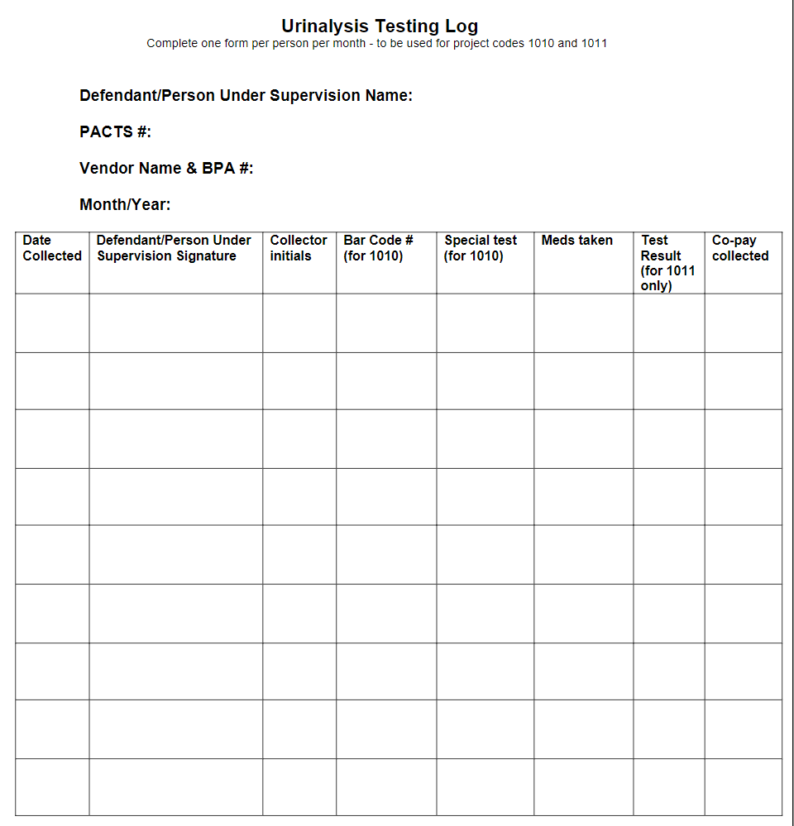

Slide 28
Documentation of services
Quarterly (90-day) Treatment Plans
  Clinical Issues and Identified Risk, Needs, Responsivity factors
  Treatment goals that are specific, measurable, achievable, relevant, and time-bound (SMART) goals
  Action steps to accomplish the treatment goals, to include appropriate type and frequency of treatment
  The client’s supportive social network (e.g., family, friends, co-workers, etc.)
  Medication management plan (if applicable)
  Collaboration and coordination for community-based services (where applicable)
  Skills to assist in managing known risk and symptoms
  Adaptable skills for self-management
  Recommendation/justification for continued treatment services
  Signed and dated by the vendor and client
Notes:
Taylor ends

Slide 29
The solicitation process
How do we find providers?
Direct contact by USPO/USPSO
Inquiries from vendors
Substance Abuse and Mental Health Service Administration (SAMSHA) Website
Referrals from existing vendors
Notes:
Tracy starts and finishes slide show from here

Slide 30
Request for proposal (RFP)
All sections are described in detail on our website. RFPs will be available to be downloaded from our website on or around June 3, 2025.
Please Note:
  Section A must be completed and submitted with a signature.
  The completed RFP can be submitted electronically, by mail or by hand.
  If providing a paper RFP, in addition to the original, one copy should also be submitted.
  Section B – Prices and Estimated Monthly Quantities (EMQ’s) must include prices for five years.
  Section C – details all required services/project codes and vendor requirements.
  Local Needs will also be required

Slide 31
Time Line
Any questions related to RFPs are to be submitted to ILNPml_TVS@ilnp.uscourts.gov. The deadline for any and all questions is 4:30 pm on Monday June 30, 2025.
Completed RFPs must be returned to U.S. Probation Office by 4:30pm on Monday June 30, 2025.
Late RFPs WILL NOT be considered.
Fiscal Year ‘26 begins on October 1, 2025. Services provision by awardees is expected to begin on this date
Blanket Purchase Agreements (BPAs)/Awards are issued for one year, with four options to renew for one year each.

Slide 32
Catchment Areas
What is it?
  Designated boundary within which the awardee provides services.
What do I need to know?
  ALL SERVICES (INCLUDING SUBCONTRACTED SERVICES) MUST BE PROVIDED WITHIN THE DESIGNATED CATCHMENT AREA!
How are the areas determined?
  By political (e.g. zip codes, counties) and natural (e.g. Lake Michigan) boundaries

Slide 33
Emq’s
What is an EMQ??
  Estimated Monthly Quantity for a service/project code.
How are EMQ’s Determined?
  Estimated by review of historical service needs in an area

Slide 34
Vendor selection
All RFPs are evaluated to determine if criteria (pass/fail) are met. This review determines whether offeror is technically acceptable.
Prices are evaluated (Competitive Bidding Process)
On-site evaluation/Site Visit
Responsibility Determination

Slide 35
Post award audits
Once Annually
Review of file storage and maintenance
File review, including focus on quality of service and CBT interventions
Review of chain of custody and specimen storage for urinalysis collection
Are all contracted services being provided?

Slide 36

Questions???

